Slide 1
Principle Component Analysis
Vera Hollink
2025

Slide 2
Multicollinearity
x₁ , x₂ ,…, correlated
Solution?
Dimension reduction: reduce the number of variables
Manually remove all but one of the correlated predictors
Automatic variable selection
Principle Component Analysis

Slide 3
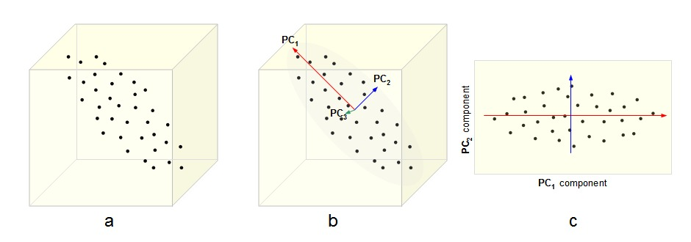
Principle Component Analysis (PCA)

Slide 4
Example with two correlated predictor variables
x1 | x2 | y
345 | 876 | 9626
456 | 234 | 9264
78 | 185 | 1636
... | ... | ...

Slide 5
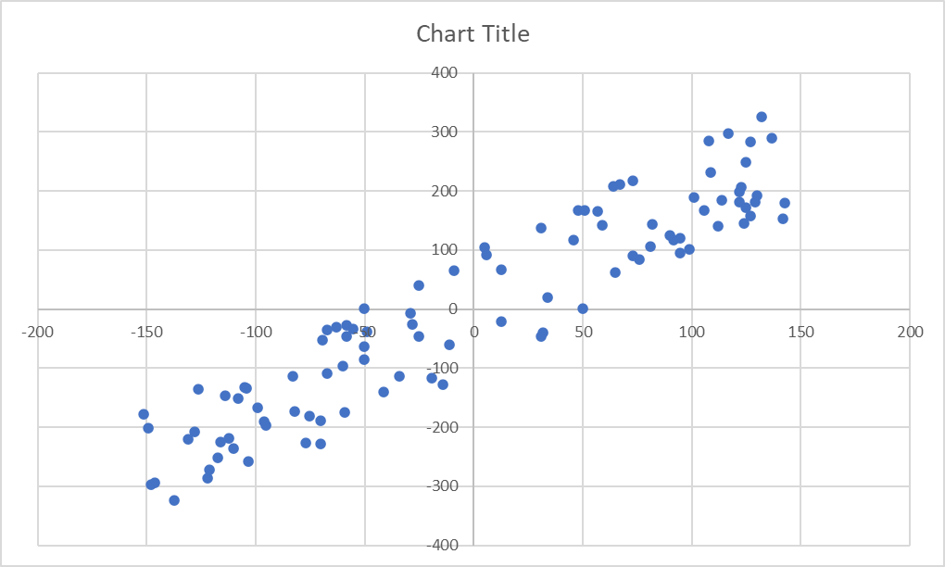


Transform data: subtract mean → data centered around origin
$$x2−\overline{x2}$$
$$x1−\overline{x1}$$

Slide 6
Transform data: rotate to new axes u, v
u
v
Drop axis v → one dimension left, most variance retained

Slide 7
PCA with three predictors
Notes:
source: http://cnx.org/content/m11461/latest/

Slide 8
Main idea of PCA
Total variance of m variables
can be explained by k components,
k < m
Component
combination of variables
c = a₁x₁ + a₂x₂ + a₃x₃ + …
Replace m variables with the k components

Slide 9
Principle components
Principle components c₁, c₂, c₃, …
m variables → m components
variances of components are as large as possible
components are uncorrelated (orthogonal)

Slide 10
Principle components
1st component
Direction with largest variance
2nd component
Direction with second largest variance
Orthogonal to first component
3rd component
Direction with third largest variance
Orthogonal to first and second component
…

Slide 11
Principle components
Number of components = number of variables
Use only some components
Why?
Otherwise we have no dimension reduction!
Which ones?
First ones, because these explain most variance

Slide 12
Principle components
For each component we get two things:
Eigenvector
the direction (coefficients of predictors)
Eigenvalue
importance of the component
corresponds to the amount of variance explained

Slide 13
Example: California housing data set
Data about house blocks in California: row = house block
longitude
latitude
housing_median_age
total_rooms
total_bedrooms
population
households
median_income
median_house_value

Slide 14
Example: California housing data set
Component coefficients (eigenvectors)
 | comp_0 | comp_1 | comp_2 | comp_3 | comp_4 | comp_5 | comp_6 | comp_7 | comp_8
longitude | -0.076 | 0.662 | 0.248 | -0.040 | 0.093 | -0.186 | -0.303 | 0.595 | 0.062
latitude | 0.076 | -0.691 | -0.128 | -0.086 | 0.072 | -0.130 | -0.300 | 0.616 | 0.049
housing_median_age | 0.216 | -0.001 | -0.050 | 0.932 | 0.272 | -0.085 | -0.018 | 0.034 | -0.005
total_rooms | -0.484 | -0.061 | -0.085 | 0.029 | 0.161 | -0.403 | -0.598 | -0.429 | 0.156
total_bedrooms | -0.490 | -0.072 | 0.041 | 0.124 | -0.143 | -0.331 | 0.296 | 0.152 | -0.705
population | -0.470 | -0.046 | 0.078 | 0.121 | 0.199 | 0.805 | -0.209 | 0.094 | -0.129
households | -0.491 | -0.072 | 0.026 | 0.145 | -0.103 | -0.079 | 0.479 | 0.181 | 0.673
median_income | -0.056 | 0.178 | -0.671 | -0.210 | 0.635 | -0.037 | 0.241 | 0.077 | -0.049
median_house_value | -0.045 | 0.192 | -0.674 | 0.166 | -0.642 | 0.120 | -0.205 | 0.104 | 0.012

Slide 15
Example: California housing data set
Component importance (eigenvalues)
Component | Eigenvalue
0 | 3.913
1 | 1.922
2 | 1.697
3 | 0.910
4 | 0.293
5 | 0.143
6 | 0.062
7 | 0.044
8 | 0.015

Slide 16
Interpreting components
Look at coefficients with large absolute values (e.g. > 0.4)
Which variables?
Which direction (positive or negative)?
 | comp_0 | comp_1 | comp_2 | comp_3 | ….
longitude | -0.076 | 0.662 | 0.248 | -0.040
latitude | 0.076 | -0.691 | -0.128 | -0.086
housing_median_age | 0.216 | -0.001 | -0.050 | 0.932
total_rooms | -0.484 | -0.061 | -0.085 | 0.029
total_bedrooms | -0.490 | -0.072 | 0.041 | 0.124
population | -0.470 | -0.046 | 0.078 | 0.121
households | -0.491 | -0.072 | 0.026 | 0.145
median_income | -0.056 | 0.178 | -0.671 | -0.210
median_house_value | -0.045 | 0.192 | -0.674 | 0.166

Slide 17
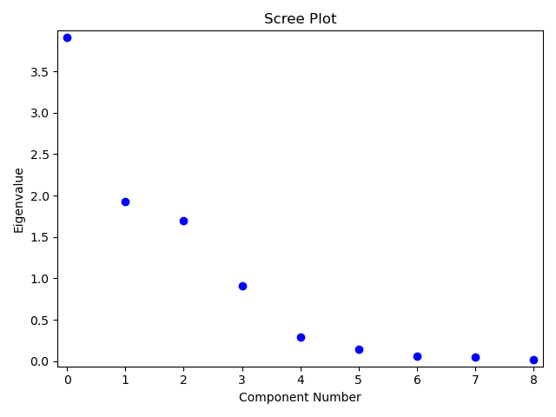
Determining the number of components
Criteria:
eigenvalue > 1 (more than one variable’s variance)
scree plot flattens out

Slide 18

PCA with statsmodels
# library
from statsmodels.multivariate.pca import PCA
…
# load and normalize data
df_housing = pd.read_csv(‘C:/…/housing.csv’)
…
scaler = preprocessing.StandardScaler()
data_scaled = scaler.fit_transform(df_housing)
…
# perform PCA
pca = PCA(df_housing, method='eig', demean=False, standardize=False)

Slide 19
PCA with Statsmodels
Demo script PCA.py

Slide 20
And now…
Exercises part 2:
Univariate Linear Regression
Multivariate Regression
Principle Component Analysis

